Slide 1
“Online Appointment System” for The Community Testing Programme (COVID-19)
Hong Kong Institute of Vocational Education (Tuen Mun) Department of Information Technology Higher Diploma in Software Engineering
Final Year Project (ITP4913M) - Presentation(2020/2021)
Group 5 member:
190169874 - Ip Man Kit
190081182 - Yen Ka Yin
190202421 - Wong Yeung Chin
190002668 – Cheuk Shu Ho

Slide 2
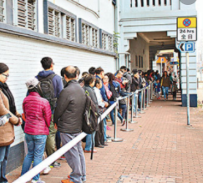




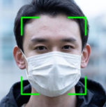

Why are we choosing this project?
✗ Physically present to make an appointment
✓ Reduce the time of getting tickets
✓ Reduce the risk of COVID-19 outbreak
Notes:
190081182

Slide 3







Background Information
Currently highest risk in Hong Kong
In 2019, COVID-19 (Coronavirus) was originated in China
>32 million confirmed cased worldwide with ~1million deaths
Researching "Online Ticketing System" could be the most effective way of detecting people with symptoms.
Provide a solution to make Hong Kong return to yesterday's prosperity
Notes:
190081182

Slide 4





The problem that we found
Waste of resources
Slow testing progress
Unpredictable of the actual situations
Time and location limit
Insufficient understanding of COVID-19
Disclosure of personal data
Inability to express a personal opinion
Increase the risk of an outbreak
Notes:
190081182

Slide 5







Our Proposed Solution
Website
(Main)
Reason: Easy to use & convenient for us to keeping informations
Android application
(Secondary)
Notes:
190081182

Slide 6
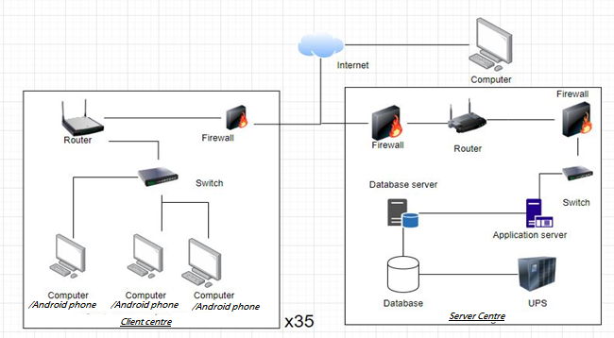
System Architecture
Configuration of Hardware, and Network:
1. Mainstream Architecture(Stable, Secure, Smooth, High efficiency)
2.Enough Hardware Resources(to support the smooth running of our system)
3. Security:2 kind of Firewall is setuped(in client center and Sever center)

Slide 7
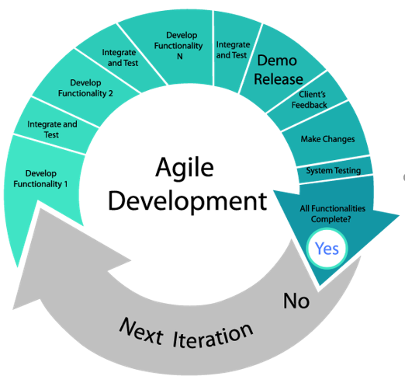
What development methodology we used
Agile Development
With unclear user requirements | Excellent
With unfamiliar technology | Poor
That are complex | Poor
That are reliable | Good
With short time schedule | Excellent
With schedule visibility | Good

Slide 8
The benefits of the development methodology
Manage change more effectively
Improve customer engagement
Focus on the highest priority first
Increase productivity
Improve transparency
Feedback from the project team
Highly collaborative environment
Visibility
Accuracy
Main features
Agree to a clear definition

Slide 9
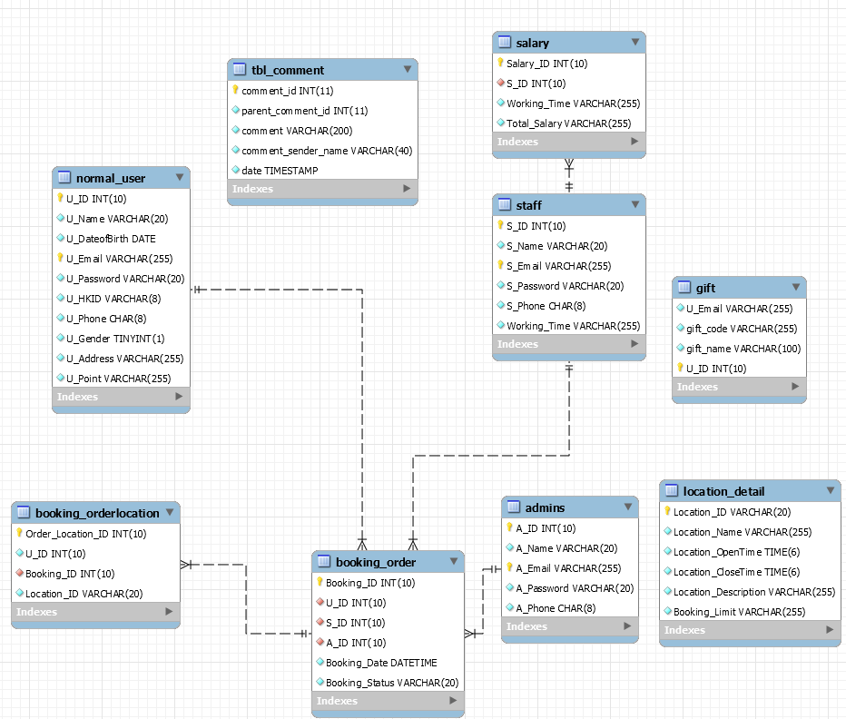
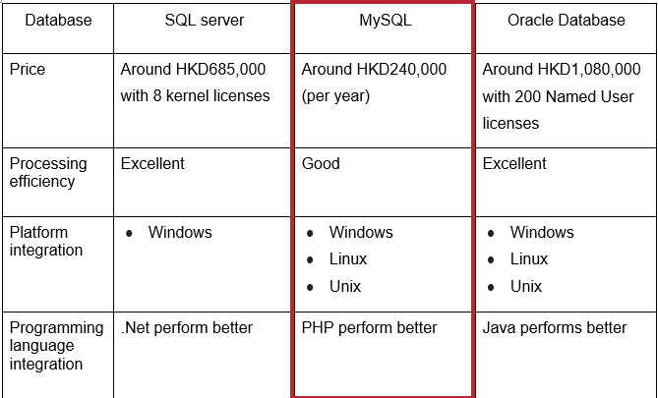
Database design
Choice:MySQL
1. price is reasonable
2. multi-platform
3. Staff have a better php knowledge

Slide 10

Functions in our “Online Appointment System” （What we did？）
Provide Search bar
Cancel Booking
Register
Login
Edit Account Information
Create Booking
Play video (COVID-19 information)
Log out
Forget Password
Chat Bot

Slide 11

Functions in our “Online Appointment System” （What we did？）
Check user booking record
Redeem a free-gift
Location mapping
View User Account (in Web-interface Only)
Auto Logout
Comment Area
Confirm Booking

Slide 12
Conclusion
Meet demand for the COVID-19 testing project
Provide the corresponding services for Hong Kong people
Lower costs to set up the website and
Effective and Feasible

Slide 13






Demo Time

